Slide 1
Interaction Diagrams
Introduction
When to use Interaction Diagrams
Sequence Diagrams
Sehrish Aqeel
www.aisciences.io

Slide 2
Interaction Diagram
Interaction diagrams model the behavior of use cases by describing the way groups of objects interact to complete the task.
Interaction diagrams are dynamic as they describe how objects collaborate.
The two kinds of interaction diagrams are
Sequence diagram
ii. Collaboration diagram

Slide 3
When to use Interaction Diagrams?
Interaction diagrams are used when you want to model the behavior of several objects in a use case.
They demonstrate how the objects collaborate for the behavior.
Interaction diagrams do not give in depth representation of the behavior.
If you want to see what a specific object is doing for several use cases use a state diagram.
To see a particular behavior over many use cases or threads use an activity diagrams.

Slide 4
Sequence Diagram
Sequence diagrams demonstrate the behavior of objects in a use case by describing the objects and the messages they pass.

Slide 5
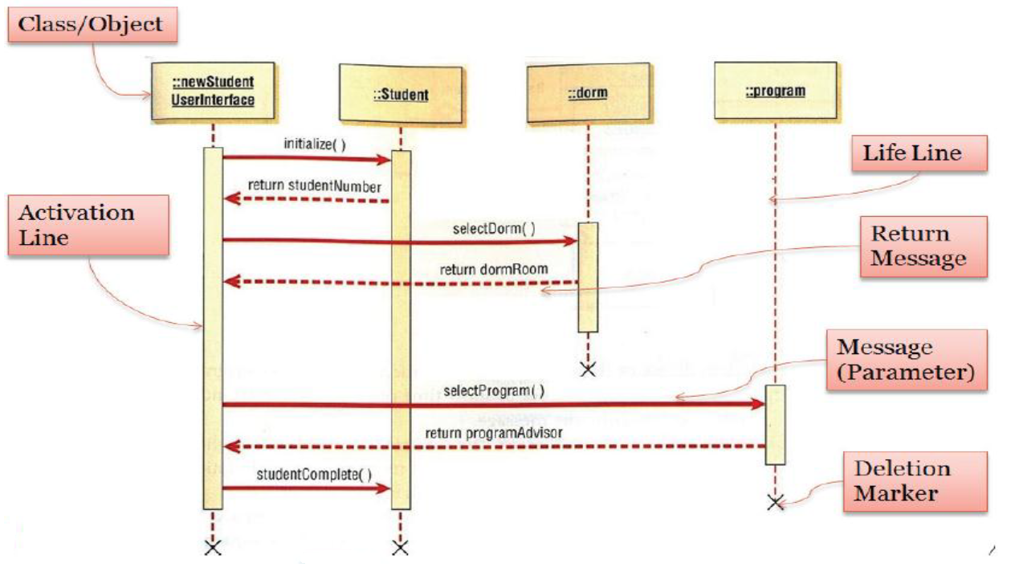
Components of a Sequence Diagram

Slide 6
Example

Slide 7
Sequence Diagram Common Mistakes
Adding too much detail. This clutters up the diagram and makes it difficult to read.
Obsolete and out of date sequence diagrams that are irrelevant when compared to the interfaces, actual architectures etc. of the system. Don’t forget to replace them or modify them.
Leaving no blank space between the use case text and the message arrow; this makes it difficult for anyone to read the diagram.
Not considering the origins of message arrows carefully.

Slide 8
Quiz

Slide 9
Project

Slide 10
Collaboration Diagrams
A collaboration diagram, also known as a communication diagram, is an illustration of the relationships and interactions among software objects in the Unified Modeling Language (UML).
These diagrams can be used to portray the dynamic behavior of a particular use case and define the role of each object.

Slide 11
Collaboration Diagrams
Collaboration diagrams are created by first identifying the structural elements required to carry out the functionality of an interaction.
A model is then built using the relationships between those elements.
Several vendors offer software for creating and editing collaboration diagrams.

Slide 12
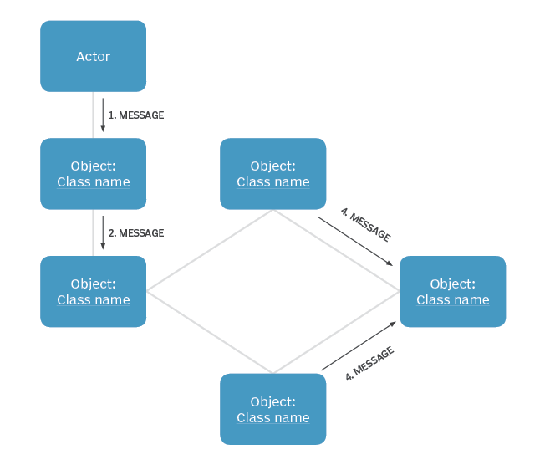
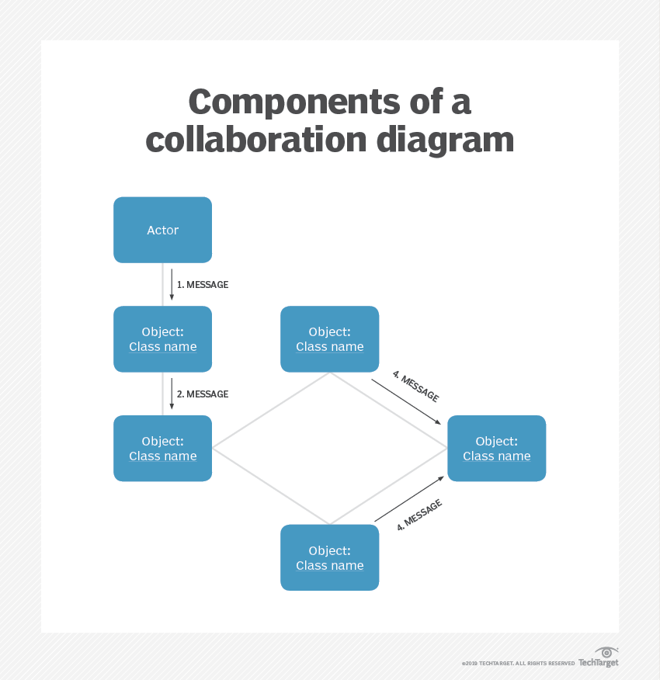
Notations of a collaboration diagram

Slide 13
When to use a collaboration diagram
Modeling collaborations, mechanisms or the structural organization within a system design.
Providing an overview of collaborating objects within an object-oriented system.
Exhibiting many alternative scenarios for the same use case.
Demonstrating forward and reverse engineering.
Capturing the passage of information between objects.
Visualizing the complex logic behind an operation.

Slide 14
Collaboration vs sequence diagrams
Collaboration diagrams are used to visualize the structural organization of objects and their interactions.
Sequence diagrams, on the other hand, focus on the order of messages that flow between objects.
However, in most scenarios, a single figure is not sufficient in describing the behavior of a system and both figures are required.

